Slide 1






Natural Language Processing of NAACCR Cancer Registry Data
NAACCR Cancer Informatics Hackathon
Team: NLP Commanders, June 2018
Kedar Dabhadkar
Aditya Chindhade
Dr. Jeffrey Bond
Wisconsin Cancer Reporting System
PhD in Biophysics, University of Rochester
Our Team
Institute of Chemical Technology, Mumbai
M.S. of Science in Chemical Engineering Carnegie Mellon University
Birla Institute of Technology and Science 2017
M.S of Science in Chemical Engineering Carnegie Mellon University
Mohit Thakur
Dr. Patrick McNeillie
Aakash Bhatia
The College of New Jersey
MS Bioinformatics Georgia Tech University
University of North Carolina 2005
UNC Medical School 2012
IBM Watson 2012-2017
National Institute of Technology Jaipur
M.S. of Chemical Engineering Carnegie Mellon University

Slide 2
Outline
Challenge Introduction
Approach
Baseline Model
Final Model
Conclusion
Future Work

Slide 3
1. Challenge Introduction

Slide 4

Problem Statement
LUNG
BREAST
Code
COLON
PROSTRATE
Expert’s notes
OTHER

Slide 5
Unformatted Generated Sample Pathology Report (from Orchard Pathology Laboratories)
Patient Name: Patient, John. M,Age 34 | DOB: 4/12/1979 Phone: (123) 555-1234. EMR: (123) 555-1234., PHYSICIAN INFORMATION: James Provider, MD ABC Medical 400 Royal Drive Anytown USA 12345 Phone: (123) 555-4321 Fax: (999) 555-4322., \\XOD\\REPORT DATE: 2/17/2013 TAT: [26 hours], Specimen: 2 cm polyp ascending colon 2 mm polyp in sigmoid colon Clinical History: Screening colonoscopy. Maternal hx of adenocarcinoma of colon age 57 Gross Examination A. The first container is labeled “ascending colon.” It contains a polypoid piece of tan mucosal tissue measuring 2.0 cm in greatest dimension. The polyp margin is inked, sectioned, and submitted in cassettes Al and A2. B. The second container is labeled “sigmoid colon.” It contains one piece of light tan mucosal tissue 0.2 cm in greatest dimension. Entirely submitted in cassette B. Microscopic Examination Microscopic Examination performed supportive of the Final Diagnosis\\XODA\\, FINAL DIAGNOSIS A. Ascending Colon SESSILE SERRATED ADENOMA (POLYP) WITH LOW-GRADE ADENOMATOUS DYSPLASIA. B. Sigmoid Colon TUBULAR ADENOMA COMMENT: \\XOD\\Patients with sessile serrated adenomas, especially with cytologic dysplasia, are at increased risk for the development of adenocarcinoma showing microsatellite instability. This progression may occur at a more rapid rate than with traditional adenomas. Complete endoscopic excision is recommended if clinically appropriate. If unresectable, repeat colonoscopy at a shortened interval (1 year), with sampling of suspicious areas or surgical resection possibly warranted.\\XODA\\ ACCESSION NUMBER 12XX0002,COLLECTION DATE: 2/15/2013 RECEIVED DATE: 2/15/2013
http://www.orchardsoft.com/files/reports/OrchardPathologyPatientReportExamples.pdf
Notes:
http://www.orchardsoft.com/files/reports/OrchardPathologyPatientReportExamples.pdf
We had to make sense of a similar block of text. Our data had special characters (e.g. \\XOD, highlighted) that had to be cleaned up first before looking at the data, which we added to simulate what our data looked like.

Slide 6
Formatted Generated Sample Pathology Report (from Orchard Pathology Laboratories)
Patient Name: Patient, John. | M | DOB: 4/12/1979 | Patient ID :54321-6 | Phone: (123) 555-1234 | EMR: (123) 555-1234
Physician Information: James Provider, MD | ABC Medical 400 Royal Drive Anytown USA 12345 | Phone: (123) 555-4321 | Fax: (999) 555-4322
Final Diagnosis: A. Ascending Colon: SESSILE SERRATED ADENOMA (POLYP) WITH LOW-GRADE ADENOMATOUS DYSPLASIA B. Sigmoid Colon: TUBULAR ADENOMA
Comment: Patients with sessile serrated adenomas, especially with cytologic dysplasia, are at increased risk for the development of adenocarcinoma showing microsatellite instability. This progression may occur at a more rapid rate than with traditional adenomas. Complete endoscopic excision is recommended if clinically appropriate. If unresectable, repeat colonoscopy at a shortened interval (1 year), with sampling of suspicious areas or surgical resection possibly warranted.
Accession Number: 12XX0002 Collection Date: 2/15/2013 Received Date: 2/15/2013 Report Date: 2/17/2013 TAT: [26 hours]
Specimen: 2 cm polyp ascending colon 2 mm polyp in sigmoid colon
Clinical History: Screening colonoscopy. Maternal hx of adenocarcinoma of colon age 57
Gross Examination A. The first container is labeled “ascending colon.” It contains a polypoid piece of tan mucosal tissue measuring 2.0 cm in greatest dimension. The polyp margin is inked, sectioned, and submitted in cassettes Al and A2. B. The second container is labeled “sigmoid colon.” It contains one piece of light tan mucosal tissue 0.2 cm in greatest dimension. Entirely submitted in cassette B.
Microscopic Examination: Microscopic Examination performed supportive of the Final Diagnosis
Notes:
During our process we formatted our reports similarly to this in case we needed to look at individual ones

Slide 7
2. Approach

Slide 8
BAG-OF-WORDS
Solution:
Make a special word dictionary!
All words
NCI
Database
Medical Expertise
New dictionary of words!

Slide 9
3. Baseline Model- Counter

Slide 10
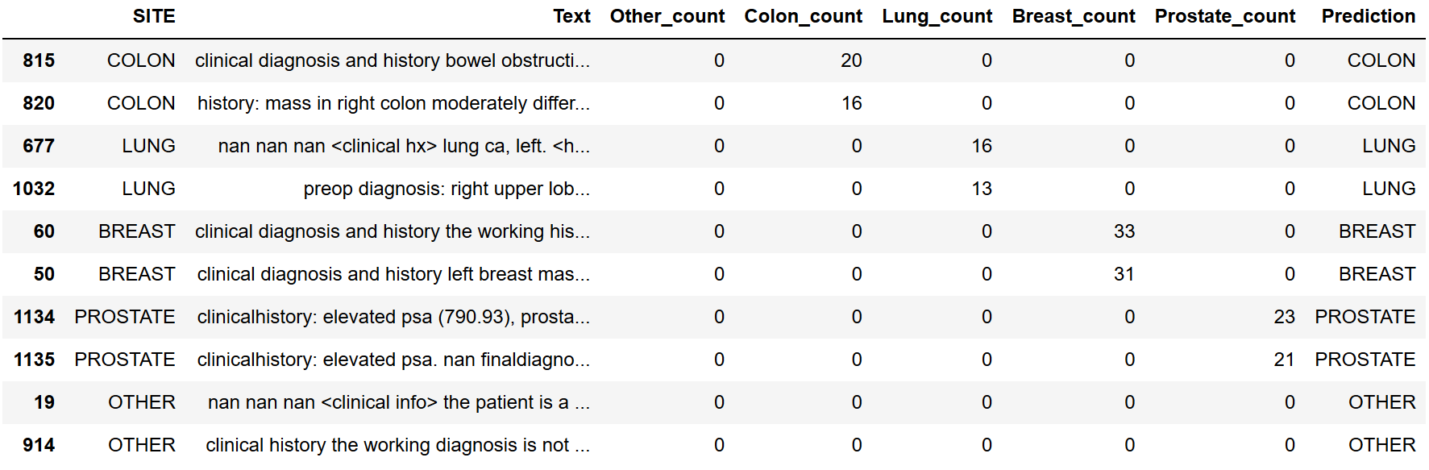
3. Baseline Model- counter
Count the occurrences of 4 keywords: Prostate, Lung, Cancer, Breast in records.
Classify the site based on the highest occurring keyword

Slide 11
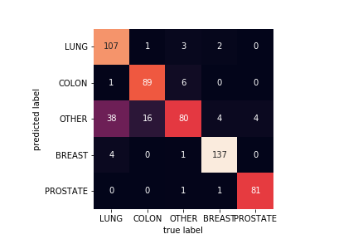
3. Baseline Model Results
Confusion matrix
F1 MACRO:
0.86078
MODEL ACCURACY:
85.76%

Slide 12
4. Final Model- Naive Bayes + SVM + Random Forests

Slide 13
4. Final Model- Naive Bayes + SVM + Random Forests
Naïve Bayes
SVM
Random
Forests

Slide 14
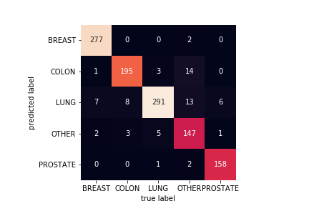
4. Final Model Results
Confusion matrix
F1 MACRO:
0.936
MODEL ACCURACY:
94.09%

Slide 15
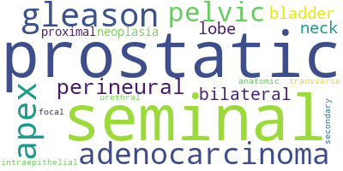
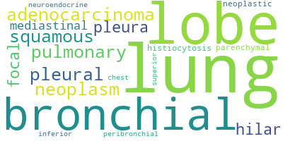
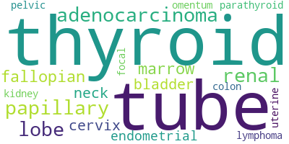
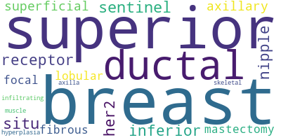
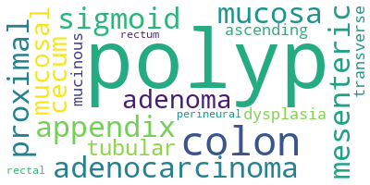
5. Conclusion
PROSTATE
LUNG
OTHER
BREAST
COLON
Notes:
These word clouds show the association between certain words and each type of cancer. These were generated from the final, curated dictionary of words from both the medical thesaurus and the reports themselves

Slide 16
6. Future work
Challenges of natural language processing
Challenge | Example
Negation | “No evidence of malignancy” in support of an OTHER classification.
Ambiguity with respect to subject | A pathological observation may refer to a historical sample. A LUNG cancer case has the phrase “cancer of the colon” because “the patient has a history of”. One pathology report may describe more than one sample. “No evidence of malignancy” occurs in a report of a cancer case because it refers to a sample from the tumor margin.
Statistical sample size | The ‘OTHER’ class is a union of very different classes. The OTHER class comprises small numbers of samples representing non-cancer as well as cancer of the blood, skin, stomach, etc.
Latent cross classification
Stochastic independence in the sample | The identity of the registry may be associated with both SITE and usage (confounding).
Notes:
Here we’ll add reports which had trickier sections, which led our model to choose a different cancer type. Our next step would ideally have been to generate a ruleset on top of our model so that these could be handled on a more narrow basis.
Negation, prior history of a different cancer, missing sections, and “OTHER” being a catch-all for any other type of reportable cancer were some of the major issues.

